Slide 1
Develop a personalized medication recommendation system based on patient health records
Submitted in the partial fulfillment for the award of the degree of
BACHELOR OF ENGINEERING
IN
DevOps
Submitted by:
Aaryan Maheshwari – 22BDO10001
Chayan Gope – 22BDO10036
Under the Supervision of:
Dr. Ranjan Walia (E14288)
Department of AIT-CSE
DISCOVER . LEARN . EMPOWER

Slide 2
Outline
Introduction to Project
Problem Formulation
Objectives of the work
Methodology used
Results and Outputs
Conclusion
Future Scope
References

Slide 3

Introduction to Project
In today's dynamic healthcare landscape, the need for personalized medication recommendations is on the rise. Leveraging patient health records presents a valuable opportunity to enhance the quality of care delivered. This presentation will delve into the significance of utilizing patient health records and how they can serve as a cornerstone for implementing tailored medication recommendation systems.

Slide 4

Introduction to Project
The focus of this presentation will be on the practical implementation of a tailored medication recommendation system. By harnessing patient health records, this system aims to elevate patient outcomes while optimizing the allocation of healthcare resources. Through real-world examples and insights, we will explore how such systems can revolutionize clinical decision-making and ultimately improve the quality of care provided to patients.

Slide 5

Problem Definition
In today's healthcare landscape, the quest for personalized medicine stands out as a critical goal. Our client, a prominent healthcare organization, acknowledges the urgent necessity to create a personalized medication recommendation system utilizing patient health records. This imperative arises from the shortcomings of conventional healthcare methodologies, which frequently depend on standardized treatment protocols instead of accommodating the distinct traits and requirements of each patient. The client aims to pioneer a transformative approach to healthcare provision, leveraging patient health records and state-of-the-art technologies to optimize therapeutic strategies and elevate patient outcomes.

Slide 6

Problem Definition
Driven by a commitment to innovation and patient-centered care, our client endeavors to revolutionize the healthcare landscape by harnessing the potential of personalized medicine. Recognizing the limitations inherent in traditional healthcare practices, the client seeks to develop a groundbreaking medication recommendation system rooted in patient health records. By prioritizing individualized treatment approaches over generalized guidelines, the client aims to redefine healthcare delivery, maximizing the effectiveness of therapeutic interventions and fostering superior patient outcomes. Through this initiative, our client endeavors to establish a new paradigm in healthcare, characterized by tailored solutions that address the unique needs and circumstances of each patient.

Slide 7

Objectives of the Work
This study aims to develop a personalized medication recommendation system utilizing patient health records. By leveraging machine learning algorithms and data analytics techniques, the system will provide tailored medication suggestions based on individual patient profiles, optimizing efficacy and safety while improving clinical decision-making processes. The research will focus on integrating clinical guidelines and pharmacogenomic data to enhance recommendation accuracy, ultimately aiming to improve treatment outcomes and patient care quality.

Slide 8
Methodology used
Data Collection and Preprocessing
Gather patient health records from electronic health record systems, including demographics, medical history, medications, laboratory results, and diagnostic reports. Preprocess the data to handle missing values, outliers, and inconsistencies. Integrate additional data sources such as genetic information and lifestyle factors if available
Feature Selection and Engineering
Identify relevant features for medication recommendation, including disease diagnoses, comorbidities, medication history, allergies, genetic markers, and lifestyle factors. Engineer new features or transformations to enhance the predictive power of the model.

Slide 9
Methodology used
Model Development
Explore various machine learning techniques such as classification, regression, and recommendation systems. Train and validate the model using appropriate evaluation metrics, considering factors like accuracy, precision, recall, and F1-score. Incorporate interpretable models to provide insights into the decision-making process.

Slide 10
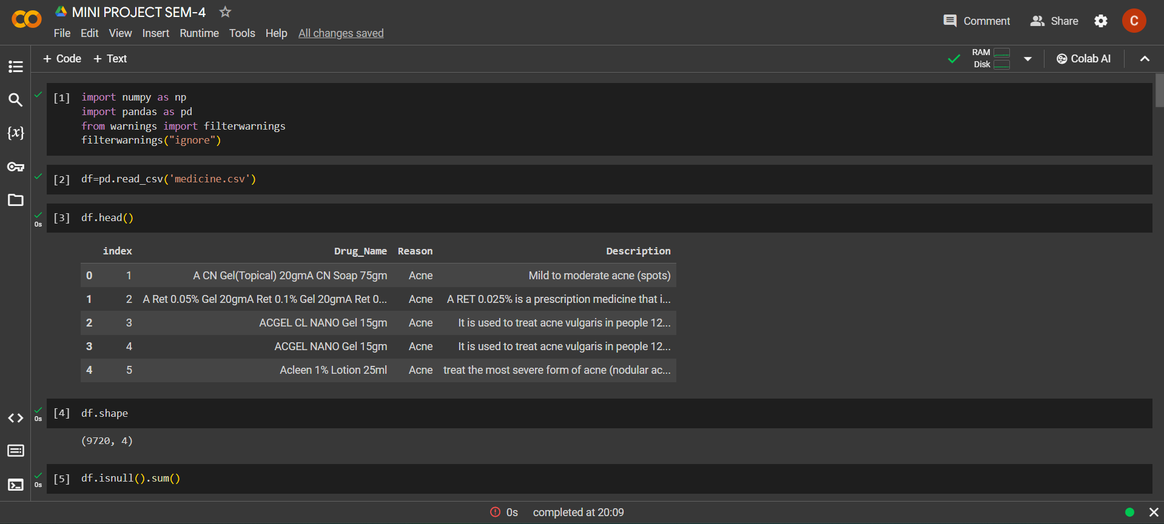
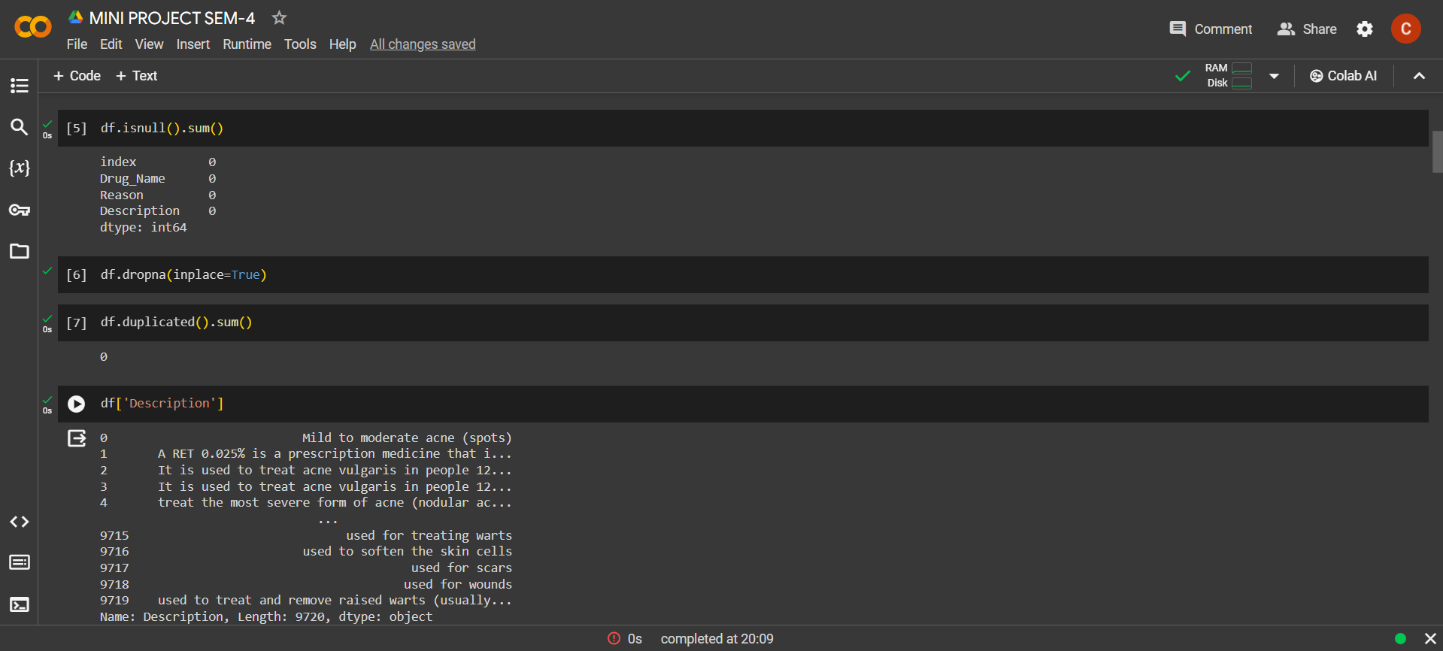
Results and Outputs

Slide 11
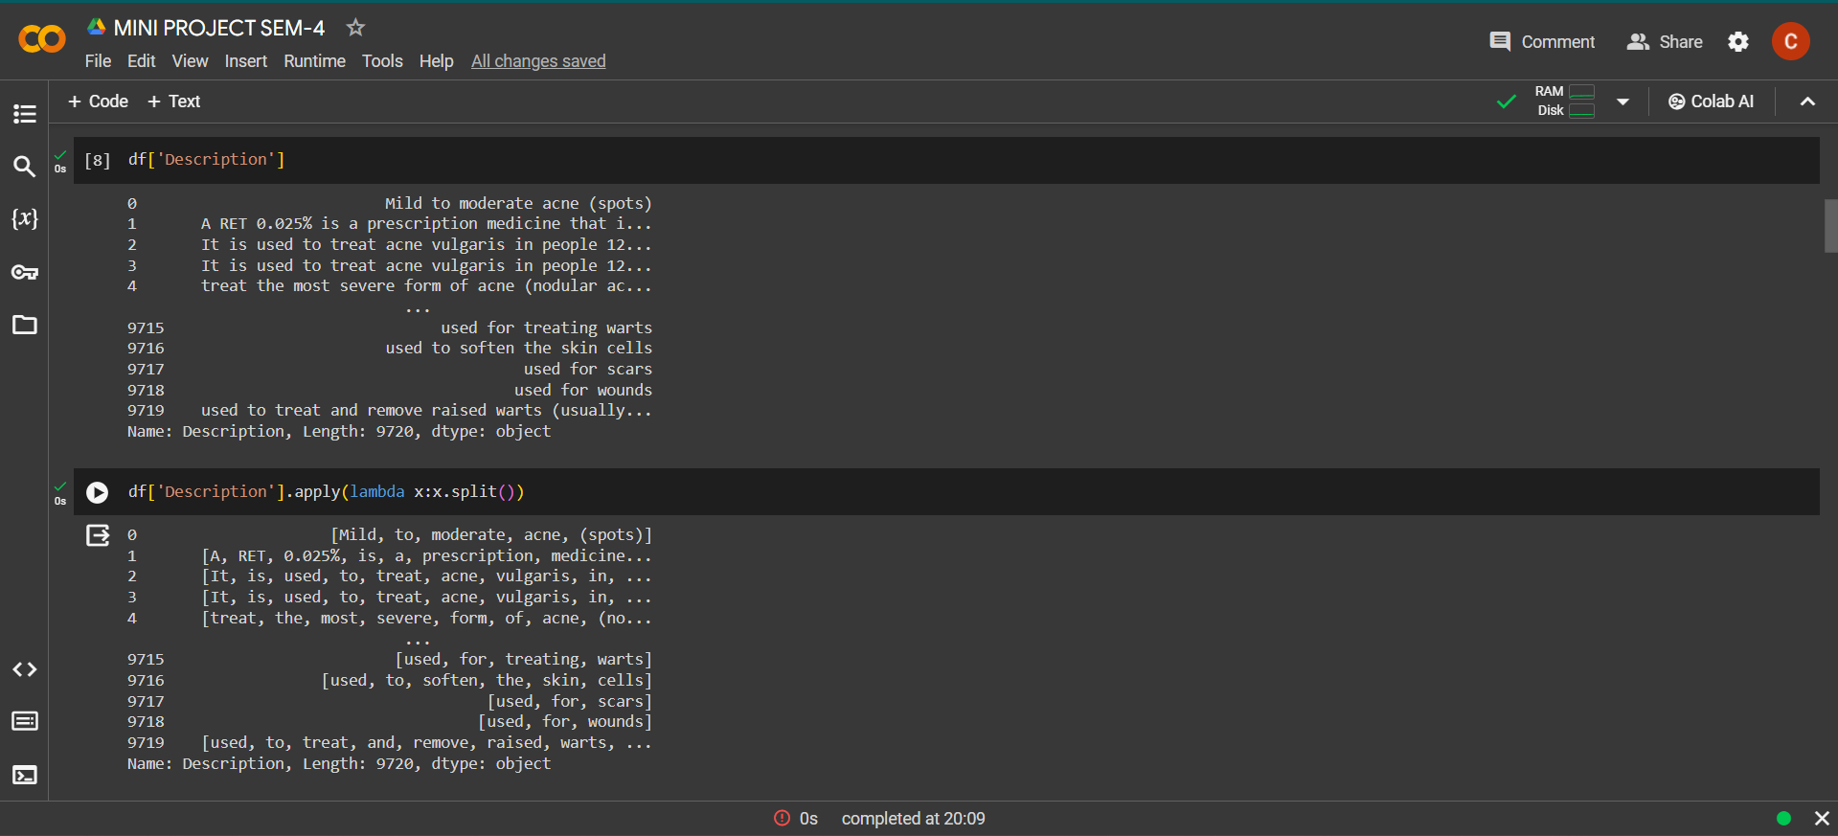
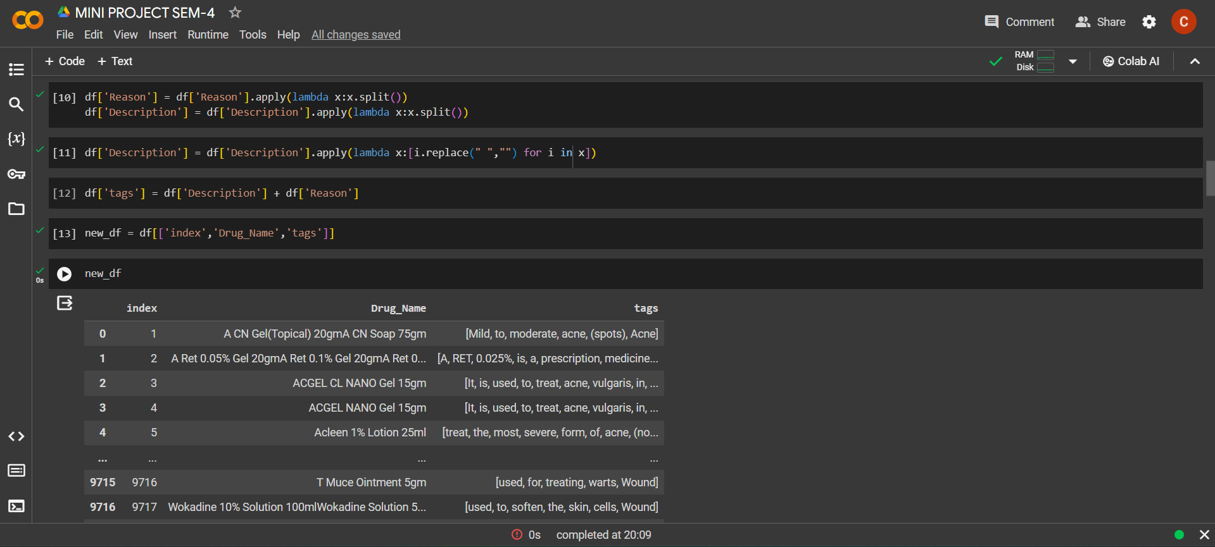
Results and Outputs

Slide 12
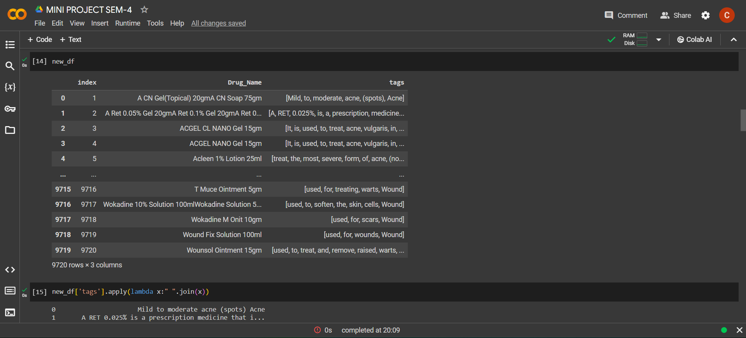
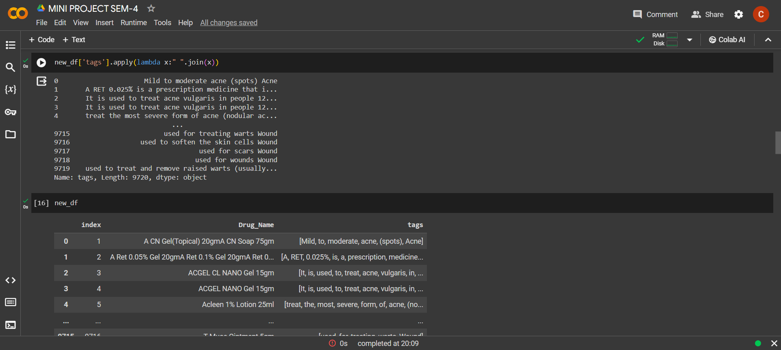
Results and Outputs

Slide 13
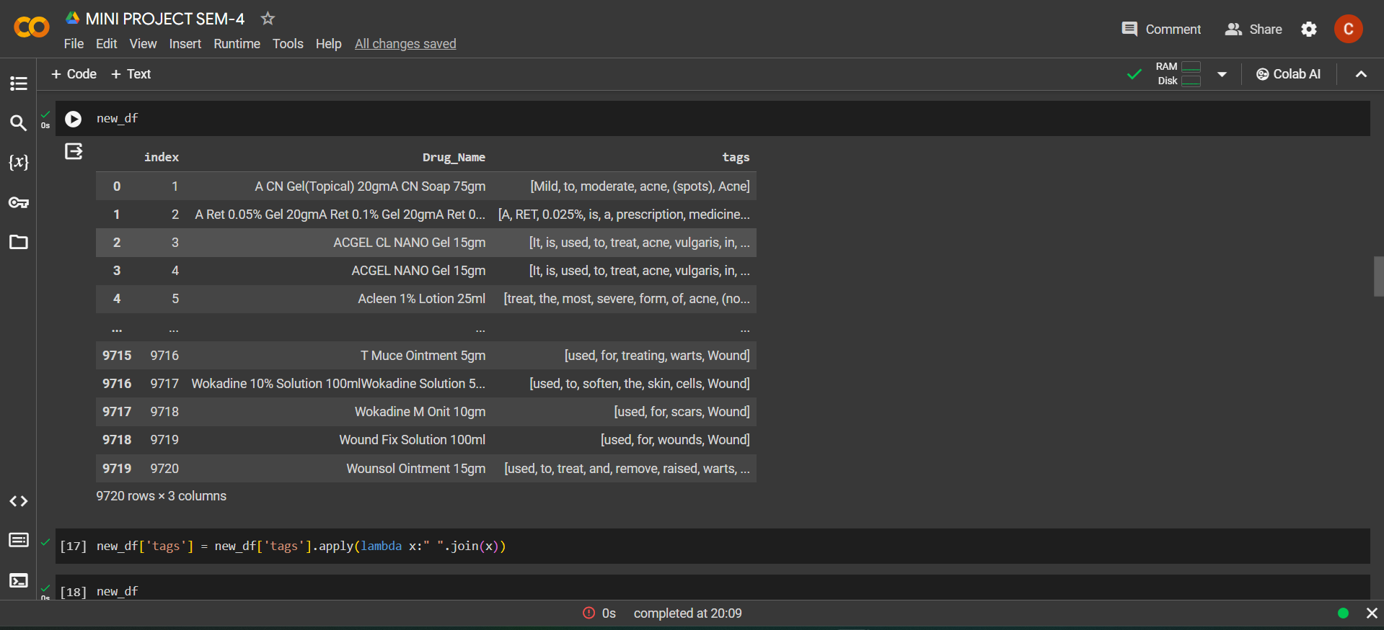
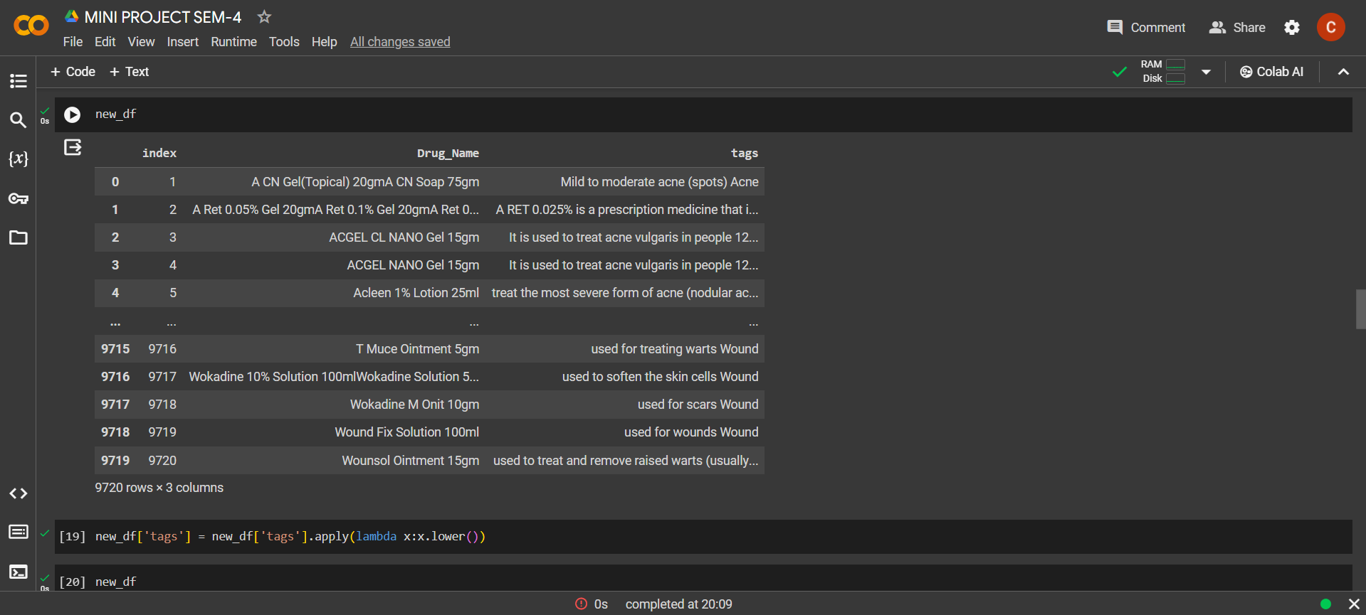
Results and Outputs

Slide 14
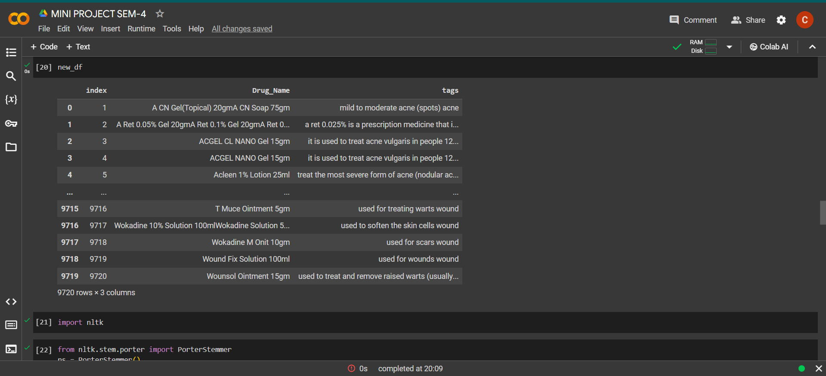
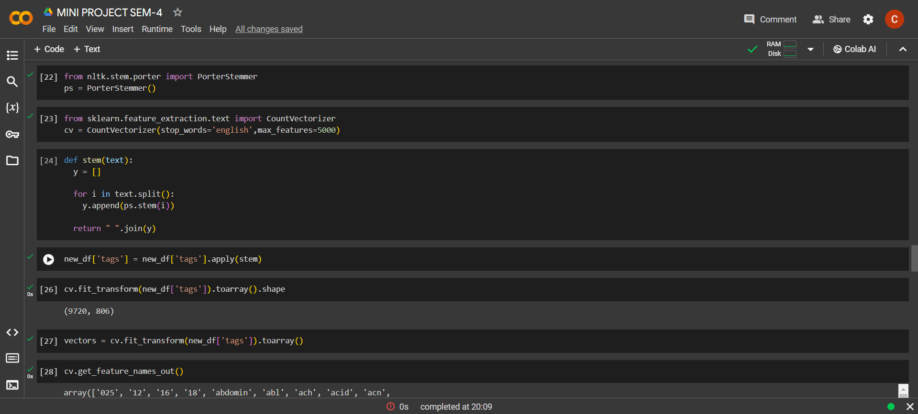
Results and Outputs

Slide 15
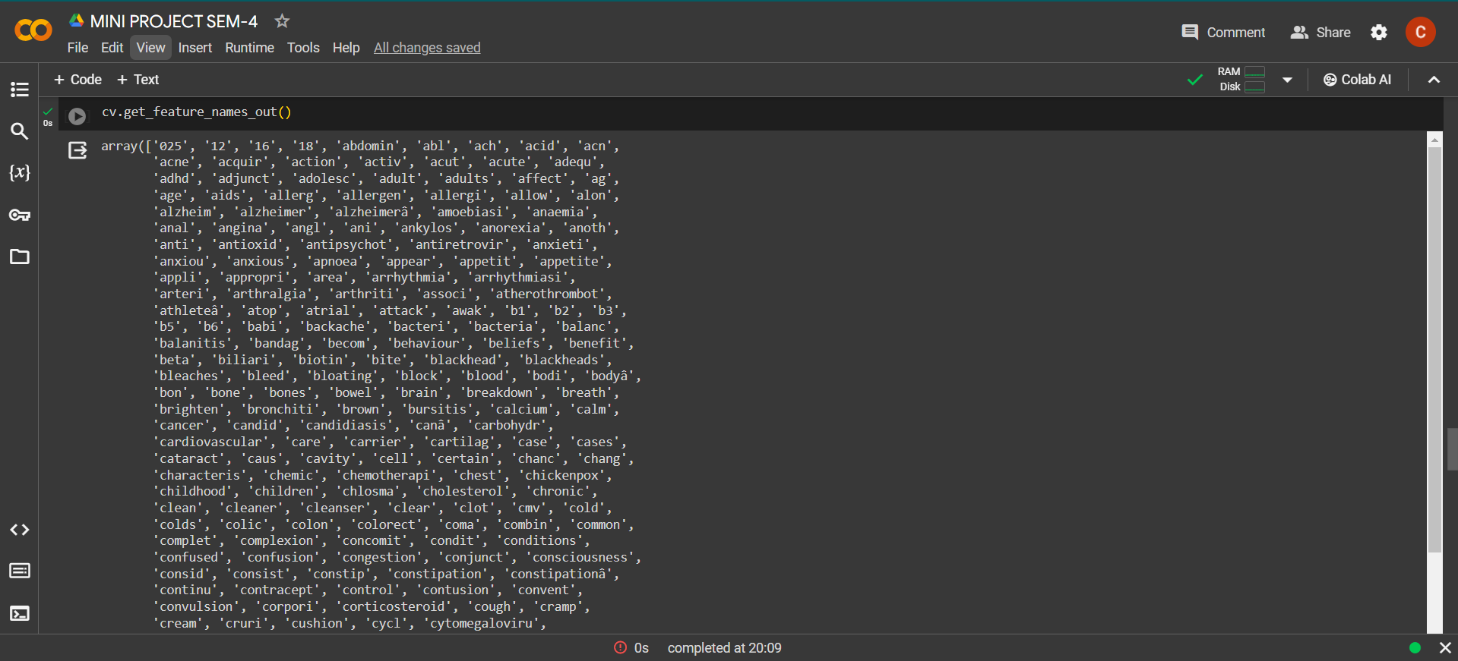
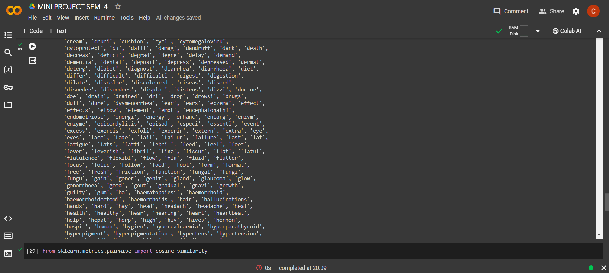
Results and Outputs

Slide 16
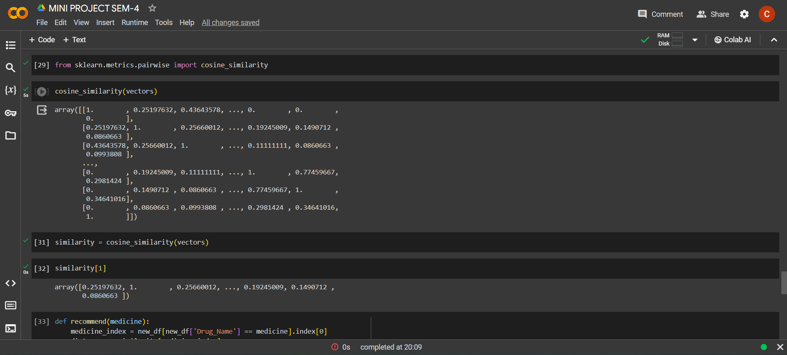
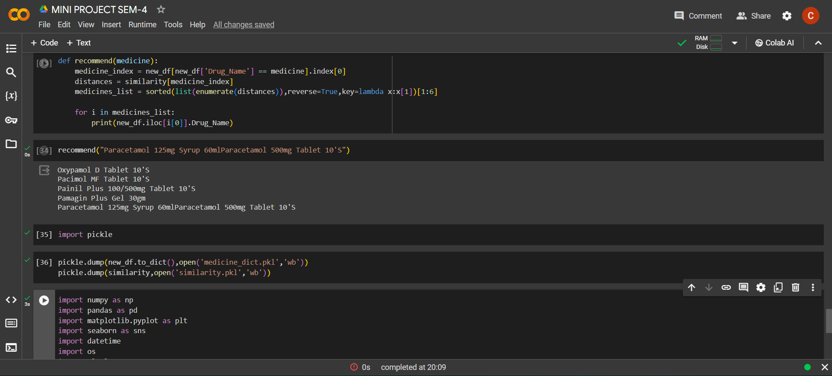
Results and Outputs

Slide 17
Conclusion
The proposed personalized medication recommendation system offers a promising approach to enhance patient care and treatment outcomes by leveraging patient health records and advanced machine learning techniques. By generating tailored medication regimens based on individual patient profiles, the system has the potential to revolutionize medication management practices and improve patient adherence, safety, and efficacy. However, further research and validation are needed to ensure the reliability, scalability, and ethical integrity of the system in real-world clinical settings.

Slide 18

Future Scope
Looking ahead, our project holds promise for several avenues of advancement in personalized medication recommendation systems. Expanding beyond patient health records, integrating real-time patient monitoring, and conducting rigorous validation studies are key areas for further exploration. Additionally, addressing ethical considerations remains essential for fostering trust and acceptance. By prioritizing these aspects, we aim to develop a robust, adaptable system that revolutionizes medication management and enhances patient outcomes across diverse clinical settings.

Slide 19
References
[1] Chaitanya Krishna Suryadevara (2021). " TOWARDS PERSONALIZED HEALTHCARE - AN INTELLIGENT MEDICATION RECOMMENDATION SYSTEM" International Engineering Journal for Research & Development 2021.
[2] Warin, K., Limprasert, W., Suebnukarn, S., Jinaporntham , S., Jantana, P., & Vicharueang, S. (2021). " Smart Recommendation Services in Support of Patient Empowerment and Personalized Medicine". Multimedia Services in Intelligent Environments, 2021.
[3] Duygu Çelik Ertuğrul, Atilla Elçi. (2021). " A survey on semanticized and personalized health recommender systems". Wiley Online Library, 2022.
[4] Y. A. Nanehkaran , Zhu Licai , Junde Chen , Qiu Zhongpan , Yuan Xiaofeng , Yahya Dorostkar Navaei ,& Sajad Einy (2014). " Diagnosis of Chronic Diseases Based on Patients’ Health Records in IoT Healthcare Using the Recommender System". School of Information Engineering, Yancheng Teachers University, Yancheng, 2014.
[5] Suman Bhoi, Mong Li Lee, Wynne Hsu, & Ngiap Chuan Tan. ( 2 0 2 1 ). " A Fine-Grained Medication Recommendation System Using Deep Learning and Personalized Drug Interaction Modeling". Journal of SingHealth Polyclinics.

Slide 20
References
[6] Zhang, Ping, et al. "Personalized medication recommendation: a review of techniques and applications." Journal of Healthcare Engineering 2017.1 (2017): 1-18.
[7] Park, Young-Taek, et al. "Personalized medication recommendation for patients with chronic diseases using electronic health records." IEEE Journal of Biomedical and Health Informatics 22.5 (2018): 1462-1472.
[8] Luo, Gang, et al. "Predicting personalized medication recommendations using electronic medical record data." Journal of Biomedical Informatics 58 (2015): 106-117.
[9] Wang, Fei, et al. "Medication recommendation systems: A narrative review and new perspectives." Journal of Biomedical Informatics 89 (2019): 11-25.
[10] Hripcsak, George, and David J. Albers. "Next-generation phenotyping of electronic health records." Journal of the American Medical Informatics Association 20.1 (2013): 117-121.

Slide 21
Thank you
Have a nice day!!

